Slide 1
Artificial intelligence & machine learning
Constrained Satisfaction based search algorithms

Slide 2
Introduction to Constraint satisfaction problems (CSP)
A problem described by imposing constraints on the variables related to a problem is called Constraint Satisfaction Problem (CSP).
A constraint satisfaction problem consists of three components X, D, and C
X is a set of variables, {X_{i}, ., X_{n},}.
D is a set of domains, {D_{i}, , D_{n}} one for each variable.
C is a set of constraints that specify allowable combinations of values.
Each domain D_{i} consists of a set of allowable values {v1,v2,…vn} for variable X.
Each constraint C_{i} consists of a tuple of variables participating in the constraint.
A constraint is a relation defining the values that variables can take on.

Slide 3
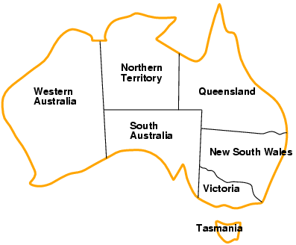
Example CSP: Map-Coloring PROBLEM
Variables WA, NT, Q, NSW, V, SA, T
Domains D_{i} = {red, green, blue}
Constraints: adjacent regions must have different colors e.g., WA ≠ NT, or (WA, NT) in {(red, green),(red, blue),(green, red), (green, blue),(blue, red),(blue, green)}.

Slide 4
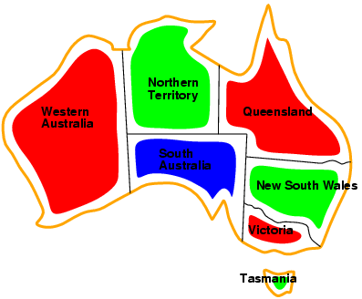
Example CSP: Map-Coloring PROBLEM
Solutions are complete and consistent assignments (WA = red, NT = green, Q = red, NSW = green, V = red, SA = blue, T = green.

Slide 5
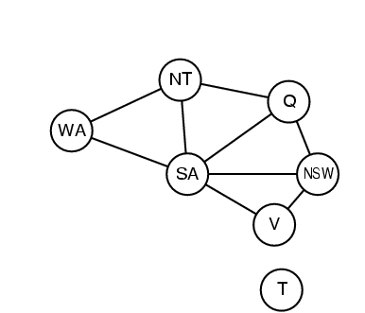
Representing Constraints as a graph
Constraint graph: nodes are variables, arcs/edges are constraints

Slide 6
Types of Variable used in A CSP problem
Discrete variables
Continuous Variable

Slide 7
Discreet VARIABLES in CSP
Discrete variables with Finite Domains (Color Graphing, 8 Queen)
If the domain size of any variable is d, then the possible number of complete assignments will be O(d^{n}), where n is the number of variables
Finite domains include Boolean values
Discrete Variables with Infinite Domains
Infinite domains are represented in terms of Integers and Strings
The number of values that can be assigned to a variable could be infinite
It is not possible to define constraints by considering all possible combinations of the values

Slide 8
Continuous variables in CSP
Continuous Variables involve continuous domain
which frequently appears in many types of problems, especially in the field of operations research
Linear programming problems fall under the category of Continuous domain where the constraints are expressed using linear in-equalities

Slide 9
Language of constraints
A constraint can be defined using a language must be used to define the constraints
Example: The job1, which can be taken after 5 days, must precede Job3, which can be represented using constraint language such as
StartJob₁ + 5 <= job3

Slide 10
Types of Constraints– CSP problem
Linear Constraints
Nonlinear Constraints
Absolute Constraints
Preference constraints

Slide 11
Types of constraints
Linear Constraints: Linear combination of Variables expressed in Mathematical expressions (Linear Equations, Linear Inequalities, Logical Expressions)
Non-Linear Constraints (Polynomial, Exponential, Trigonometric and Logarithmic )
Absolute Constraints: Constraints are imposed on the variables using either absolute values or inequalities
Preference Constraints: Constrained imposed based on the user preferences (Ex. In a university timetabling problem, Prof. X might prefer teaching in the morning, whereas Prof. Y prefers teaching in the afternoon).

Slide 12
Classification of constraints
Unary constraints involve a single variable(SA ≠ green)
Binary constraints involve pairs of variables (SA ≠ WA)
Higher-order constraints involve 3 or more variables (crypt arithmetic column constraints

Slide 13
Example Application implemented using CSP
Solve cryptographic arithmetic puzzles using Constraint Satisfaction Problem (CSP) techniques.
A classic example is the SEND + MORE = MONEY puzzle, where each letter represents a unique digit (0-9).
Solve this puzzle using CSP concepts.

Slide 14
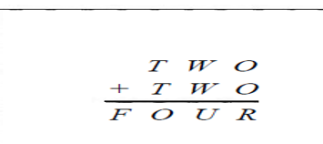
Cryptographic Arithmetic Problem
Each Letter stands for a distinct digit. The aim is to find a substitution of digits for letters such that the resulting sum is arithmetically correct with the added restriction that no leading zeros are allowed

Slide 15
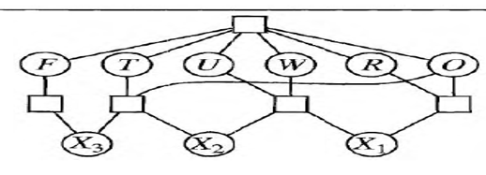
Constraint GRAPH Cryptographic Arithmetic Problem

Slide 16
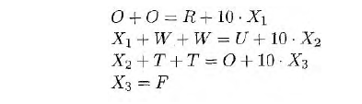
Identifying Constraints Cryptographic Arithmetic Problem
The constraint Graph shows all diff constraints as well as column addition constraints. Each Square Box is a Constraint connected to the variables that it constrains.
Variables F, T, U, W, R, O
Constraints
Addition Constraints: F ≠ U and –F ≠ T

Slide 17
Real-world Applications requiring CSP Searches
Assignment problems (e.g., who teaches what class)
Timetabling problems(e.g., which class is offered when and where?)
Transportation Scheduling
Factory Scheduling

Slide 18
Standard search formulation
States are defined by the values assigned.
Initial state: the empty assignment { }
Successor function: assign a value to an unassigned variable that does not conflict with the current assignment. Fail if no legal assignments exist
Goal Test: The current assignment is complete
This is the same for all CSPs
Every solution appears at depth n with n variables→ use depth-first search
Path is irrelevant, so we can also use complete-state formulation
b = (n - l )d at depth l

Slide 19
Components of CSP based Search
Initial state: the empty assignment in which all variables are unassigned.
Successor function: a value can be assigned to any unassigned variable, if it does not conflict with a previously assigned value
Goal test: The current assignment is complete.
Path cost: A constant cost of 1 for every step.
^{Some observations}
^{The Search is complete}
The solution Appears at a depth n where n is the number of variables existing in the problem
Depth First Search Algorithms are best suited for solving the CSP

Slide 20
CSP Search Algorithms
Forword Search
Backword Tracking

Slide 21
Forward Checking Algorithm
Initialize:
Start with the initial assignment of variables and their domains.
Create an empty set to store the list of constrained variables.
2. Select Variable: Choose a variable to assign a value to. This can be based on heuristics like Minimum Remaining Values (MRV) or Degree Heuristic.
3. Select Value: Choose a value from the domain of the selected variable. This can be based on heuristics like Least Constraining Value (LCV).
4. Assign Value: Assign the selected value to the selected variable.
5. Update Domain: For each unassigned variable adjacent to the variable just assigned, remove the selected value from their domains.

Slide 22
Forword Checking ALgorithm
6. Check Domain Emptiness: If any domain becomes empty, backtrack to the previous variable and try a different value.
7. Check for Solution: If all variables are assigned values and all constraints are satisfied, you have found a solution.
8. Recursive Step: If not all variables are assigned, recursively repeat steps 2-7 for the next variable.
9. Backtrack: If you reach a point where no value can be assigned to the current variable, backtrack to the previous variable and try a different value.
10. Return Solution or Failure: If a solution is found, return it. If you reach a point where all possible assignments have been tried and none succeed, report failure.

Slide 23
Forword Checking ALgorithm
11. Undo Assignments: Before backtracking, undo the assignment of the current variable, and restore the domains of variables that were updated.
12. Continue Search: Continue the search process until a solution is found or all possible assignments have been tried.

Slide 24
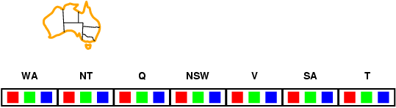
Solving the CSP problems through Forward checking
Idea
Keep track of remaining legal values for unassigned variables. Terminate the search when any variable has no legal values.

Slide 25
Representing Constraints as a graph
Constraint graph: nodes are variables, arcs/edges are constraints

Slide 26
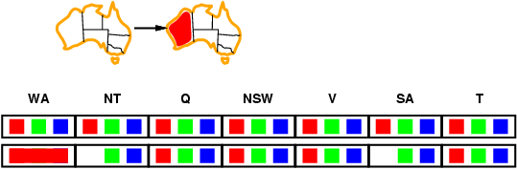
Solving the problems through Forward checking
Idea:
Keep track of remaining legal values for unassigned variables
Terminate search when any variable has no legal values

Slide 27
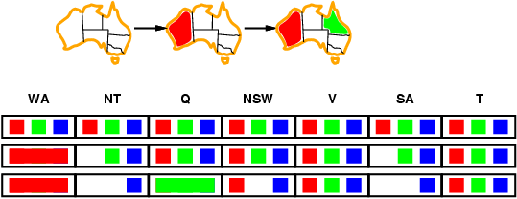
Solving the problems through Forward checking
Idea:
Keep track of remaining legal values for unassigned variables
Terminate search when any variable has no legal values

Slide 28
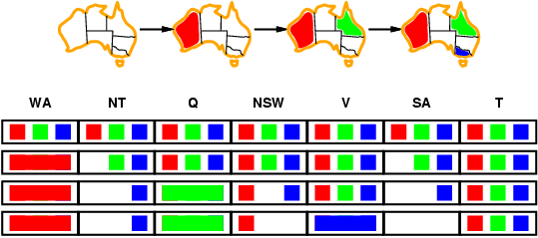
Solving the problems through Forward checking
Idea:
Keep track of remaining legal values for unassigned variables
Terminate search when any variable has no legal values

Slide 29
Solving the problems through Forward checking
Idea:
Forward checking propagates information from assigned to unassigned variables, but doesn't provide early detection for all failures:
NT and SA cannot both be blue!
Constraint propagation algorithms repeatedly enforce constraints locally

Slide 30
Constraint propagation
In regular state-space search, an algorithm can do searching.
In CSPs, an algorithm can choose a new variable value from several possibilities while searching
In CSP, “constraint propagation” can also be made while doing the search.
Constraint Propagation means using the constraints to reduce the number of legal values for a variable, which can reduce the legal values for another variable, and so on.
Constraint propagation may be intertwined with the search, or it may be done as a preprocessing step, before the search starts
Sometimes preprocessing can solve the whole problem itself without the necessity of employing the search.

Slide 31
Local Consistency
Local consistency is a property in Constraint Satisfaction Problems (CSPs) that characterizes the level of constraint propagation achieved during the search process.
It refers to the extent to which the constraints in a CSP have been enforced among neighboring variables.

Slide 32
Local consistency
There are different types of local consistency.
Node consistency
Arc consistency
Path consistency
K-consistency

Slide 33
NODE consistency
This is the simplest form of consistency.
It involves ensuring that each variable in the CSP satisfies its individual unary constraints (constraints that involve only one variable).
For example, if a variable x has a unary constraint x > 3, then the domain of x would be reduced to values greater than 3.

Slide 34
ARCH consistency
Arc Consistency extends node consistency by considering binary constraints (constraints that involve two variables).
It ensures that for every pair of variables (x, y) and for every value in the domain of x, there is at least one value in the domain of y that satisfies the binary constraint. If not, the inconsistent value is removed from the domain of x.
AC-3 is a widely used algorithm for enforcing arc consistency.

Slide 35
Path consistency
Path consistency is a stronger form of consistency that extends arc consistency.
It enforces constraints over longer paths in the constraint graph.
It checks for consistent values along chains of variables connected by binary constraints.
This helps in propagating constraints more effectively.

Slide 36
Backtracking search in CSP

Slide 37
Introduction - Backtracking search
Backtracking is a fundamental algorithmic technique for solving Constraint Satisfaction Problems (CSPs).
It systematically explores the search space of possible assignments to variables while using constraints to prune branches unlikely to lead to a solution.

Slide 38
Introduction - Backtracking search
The term backtracking search is used for a depth-first search that chooses values for one variable at a time and backtracks when a variable has no legal values left to assign.
An unassigned variable is chosen, and then all values in that variable's domain are tried to find a solution.
If an inconsistency is detected, then BACKTRACK returns failure, causing the previous call to try another value
Backtracking considers assignments to a single variable at each node
Depth-first search for CSPs with single-variable assignments is called backtracking search

Slide 39
Step by STEP procedure – Backtracking algorithm
Initialization: Start with an initial assignment of values to variables. If some variables are already assigned, this could be an empty or partial assignment.
Select Unassigned Variable: Choose an unassigned variable from the variables that still need to be assigned a value.
The choice of a variable can be based on various heuristics, like the most constrained variable or the variable with the fewest legal values.
3. Order Domain Values: Order the selected variable’s domain values. The order can be based on heuristics, like the least constraining value that rules out the fewest choices for other variables.

Slide 40
Step by STEP procedure – Backtracking algorithm
4. Value Assignment:
For each value in the domain of the selected variable:
Assign the value to the variable.
Check if the assignment violates any constraints with the already assigned variables. If a constraint is violated, backtrack to step 2.
5. Constraint Propagation:
After assigning a value, apply constraint propagation techniques. This could involve revising the domains of other variables based on the newly assigned variable and the constraints. Common techniques include arc consistency and domain reduction.

Slide 41
Step by STEP procedure – Backtracking algorithm
Recursive Step or Backtrack:
If no inconsistency is found after assigning a value and applying constraint propagation, proceed recursively to the next variable and repeat steps 2 to 5.
If a variable's domain becomes empty (no valid choices left) due to the assignment, backtrack to the previous variable and undo the assignment (backtrack step).
7. Solution Found: A solution has been found if all variables are assigned values and all constraints are satisfied. Return the assignment.

Slide 42
Step by STEP procedure – Backtracking algorithm
8. Backtrack: If the search reaches a dead-end (all values for a variable have been tried, and none lead to a solution), backtrack to the previous variable, undo its assignment, and continue the search from there.
9. Termination: Continue until a solution is found or all possible assignments have been explored.

Slide 43

Backtracking example – Color Graph

Slide 44
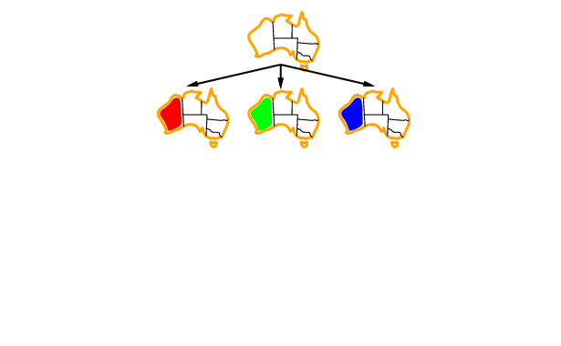
Backtracking example

Slide 45
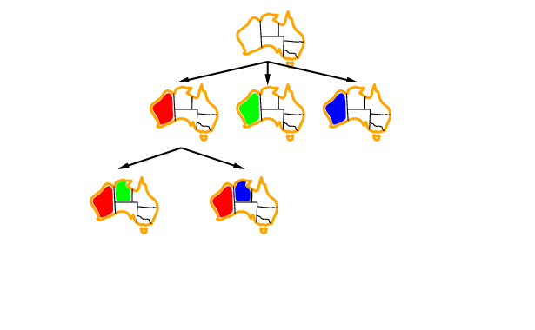
Backtracking example

Slide 46
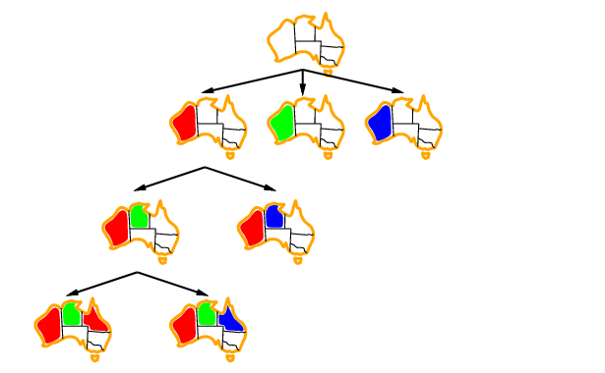
Backtracking example

Slide 47
Improving backtracking efficiency
General-purpose methods can give huge gains in speed:
Which variable should be assigned next?
In what order should its values be tried?
Can we detect inevitable failure early?

Slide 48
Minimum Remaining Value Heuristics
By default, the SELECT-UNASSIGNED-VARIABLE function selects the next unassigned variable in the order given by the list
This static variable ordering seldom results in the most efficient search.
For example, after the assignments for WA = red and NT = green, there is only one possible value for SA, so it makes sense to assign blue to SA next rather than to Q.
In fact, after SA is assigned, the choices for Q, NSW, and V are all forced.
This intuitive idea of choosing the variable with the fewest "legal" values is called the remaining values (MRV) heuristic.

Slide 49
Minimum Remaining Value
It is also has been called the "most constrained variable" or "fail-first" heuristic because it picks a variable that is most likely to cause a failure soon, thereby pruning the search tree.
If there is a variable X with zero legal values remaining, the MRV heuristic will select X, and failure will be detected immediately.

Slide 50
Selecting Variables with Highest Degree
The MRV heuristic doesn't help choose the first region to colour in Australia because, initially, every region has three legal colours.
In this case, the degree heuristic comes in handy. It attempts to reduce the branching factor on future choices by selecting the variable involved in the largest number of constraints on other unassigned variables.
SA is the variable with the highest degree, 5; the other variables have degrees 2 or 3, except for T, which has 0.

Slide 51
Selecting Variables with Highest Degree
In fact, once SA is chosen, applying the degree heuristic solves the problem without any false steps-you can choose any consistent colour at each choice point and still arrive at a solution with no backtracking
The minimum remaining values heuristic is usually a more powerful guide, but the degree heuristic can be useful as a tie-breaker.
Once a variable has been selected, the algorithm must decide on the order in which to examine its values.

Slide 52
Selecting Variables with Highest Degree
The minimum remaining values heuristic is usually a more powerful guide, but the highest degree heuristic can be useful as a tie-breaker.
Once a variable has been selected, the algorithm must decide how to examine its values.
For this, the least-constraining-value heuristic can be effective in some cases. It prefers the value that rules out the fewest choices for the neighbouring variables in the constraint graph.
For example, suppose we have generated the partial assignment with WA = red and NT = green, and our next choice is for Q. Blue would be a bad choice because it eliminates the last legal value left for Q's neighbour, SA.

Slide 53
Selecting Variables with Highest Degree
The least-constraining-value heuristic, therefore, prefers red to blue.
In general, the heuristic is trying to leave the maximum flexibility for subsequent variable assignments. Of course, if we are trying to find all the solutions to a problem, not just the first one, then the ordering does not matter because we have to consider every value anyway. The same holds if there are no solutions to the problem.

Slide 54
CSP Summary
CSPs are a special kind of problem
States defined by values of a fixed set of variables
Goal test defined by constraints on variable values
Backtracking = depth-first search with one variable assigned per node
Variable ordering and value selection heuristics help significantly
Forward checking prevents assignments that guarantee later failure
Constraint propagation (e.g., arc consistency) does additional work to constrain values and detect inconsistencies
Iterative min-conflicts is usually effective in practice

